Slide 1
Lending Club Case Study
By
Sukanya Desikan
Niranjan Harpale

Slide 2
Business Understanding
Lending Club company is the largest online loan marketplace, facilitating personal loans, business loans, and financing of medical procedures.
When the company receives a loan application, the company has to make a decision for loan approval based on the applicant’s profile.
Credit Loss: Lending loans to ‘risky’ applicants is the largest source of financial loss. It is the amount of money lost by the company when the borrower refuses to pay or runs away with the money owed.
In this case, the customers labelled as 'charged-off' are the 'defaulters'.
If the applicant is likely to repay the loan, then not approving the loan results in a loss of business to the company.
The company wants to understand the driving factors (or driver variables) behind loan default.

Slide 3
Analysis Objective
To identify these risky loan applicants, then such loans can be reduced thereby cutting down the amount of credit loss.
The company wants to understand the driving factors (or driver variables) behind loan default.
Give recomendations for approving loans of the applicants.
Company can utilise this knowledge for its portfolio and
risk assessment.

Slide 4
Analysis Approach
Data Understanding & Cleaning
1. Find Categorical and Quantitative
Variables.
2. Analyze, check distribution of each
of these variables.
3. Add derived columns if required.
4. Plot graphs and take insights.
Univariate Analysis
Data Frames
Data Cleaning
Data For
Analysis
Exploratory Data Analysis
1. Driving factors behind
loan default.
2. Observations from
Analysis.
2. Recommendations to
Lenfing Club.
Bivariate Analysis
Results
1. Analyze two attributes together.
2. Find the correlation between
different variables.
3. Perform correlation analysis with
plotting correlation matrix.
4. Add derived columns if required.
5. Plot graphs of two variables
and observe the how they
effect each other.
1. Analyze each categorical and
quanitative variables according
to the segments of values.
2. Add derived columns if required.
3. Plot graphs of the segments
and take insights.
Segmented Univariate Analysis

Slide 5
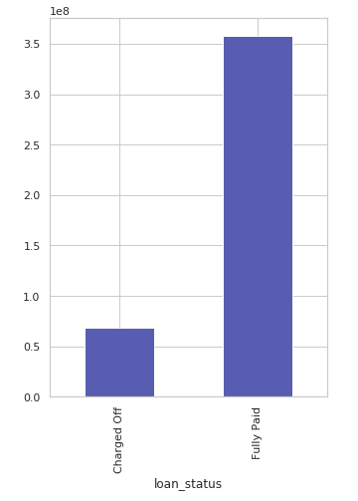
Loan Status
The company has approved 38,577 different loan requests.
Out of 38,577 loans approved by company 5,627 loans are defaulted.
The Company has lost around 68 million in defaulted loans.

Slide 6
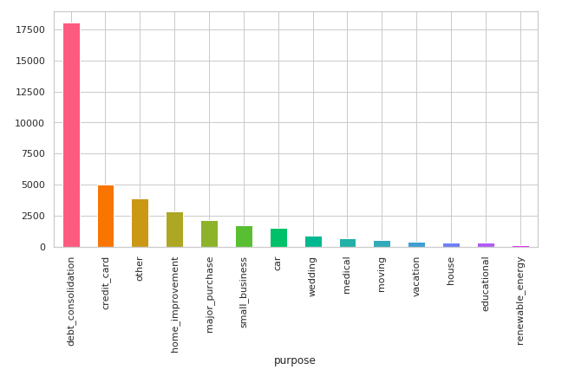
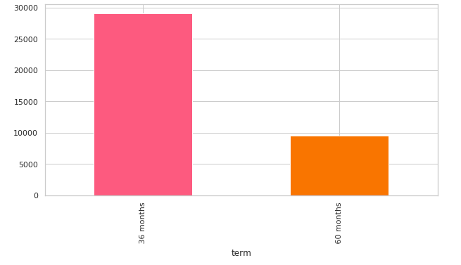
Loans Approved: Purpose & Term
Most of the loans are taken for debt consolidation, followed by credit card.
Loans are given for either 36 months or 60 months periods.
Most loans are given for 36 months term.

Slide 7
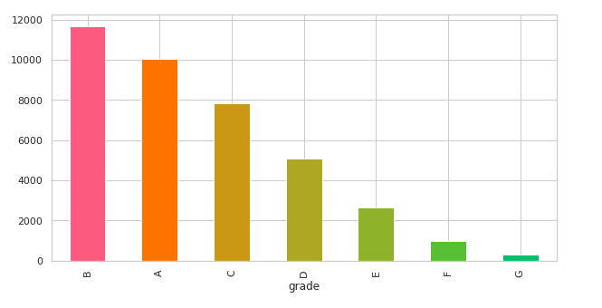
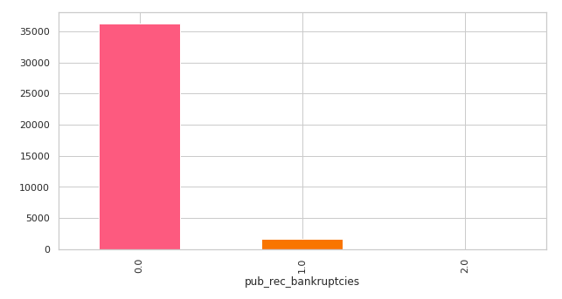
Loans Approved: Grades & Bankruptcy Record
Most loans approved are High grade.
Lending club has approved less loans for customers having prior bankruptcy records.
In contrast to that, it has approved loans of customers with no prior bankruptcy record.

Slide 8
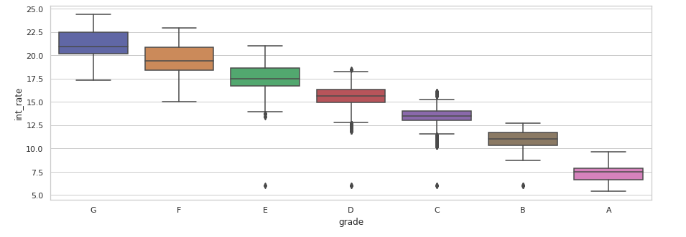
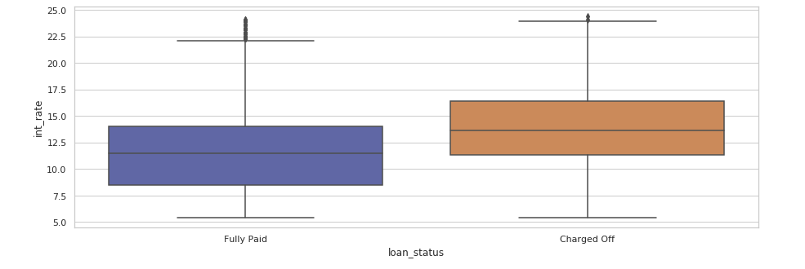
Loans Approved: Interest Rates
Lending club charged higher interest rates for low grades
Also, lending club charges low interest rates for high grades.
People with higher interest rate tend to charge-off.
Most People who charged_off has higher interest rate on their loan, it was also observed that, loan_amnt was also high for these people

Slide 9
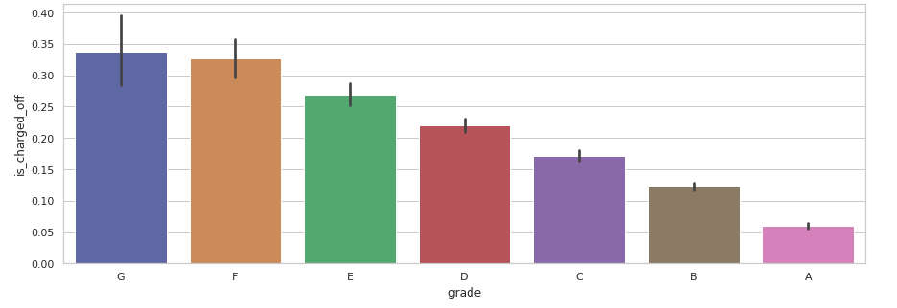
Defaults by Grades
Loans with grade G, F and E have higher default rates.
Grade A is considered as high level and Grade G id considered as low level grades.

Slide 10
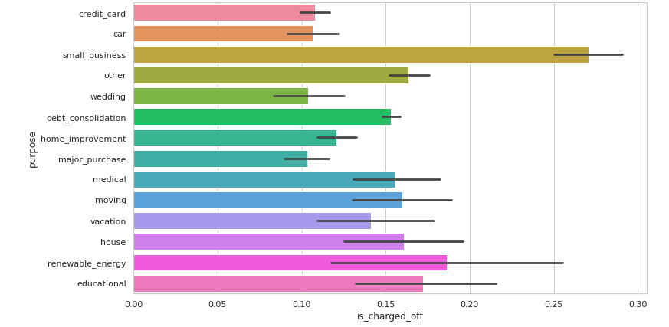
Defaults by Purpose
Loans taken for “Small Business” purpose has more default rate.
Also we can see high default rates in renewable energy, educational, house, debt consolidation, medical, moving purposes.

Slide 11
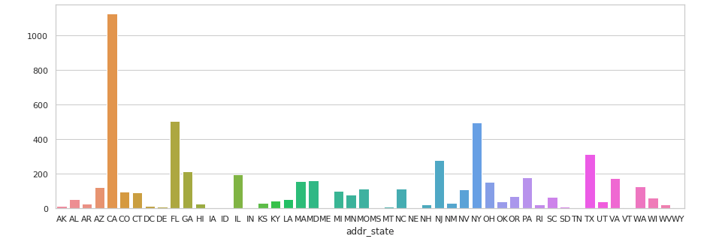
Defaults by Location
We see more defaulter from California (CA), New York (NY), Texas (TX), Florida (FL).
Lending club must need to verify customers from such places.

Slide 12
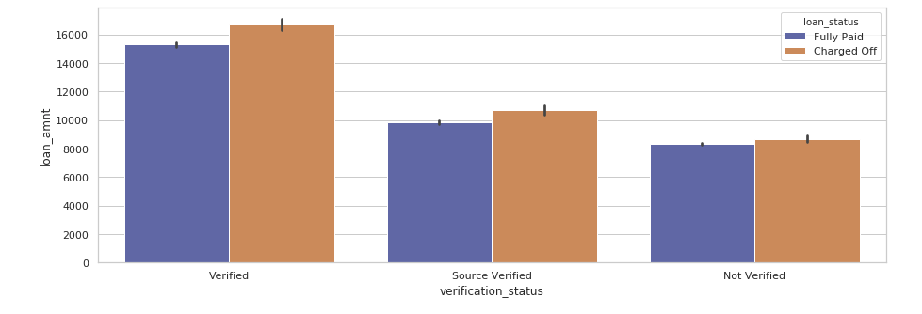
Defaults by Verification Status
Club is verifying customers requesting higher loan amount.
Even after verification of customer, we see the highest default rate from it.
Also notice the defaulters from not-verified source.

Slide 13
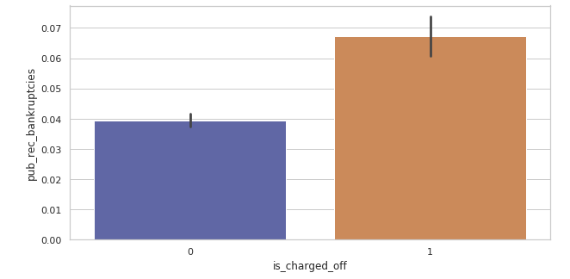
Defaults by Bankruptcy Records
Lending club does not approve laons of customers with Prior bankruptcy records.
Hence we dont see any customer with 2 or more bankruptcy records being defaulter.
But we see customers even with one prior bankruptcy records tend to default.

Slide 14
Recommendation:
Things Lending Club is doing RIGHT!
Most loans approved are High grade.
By not approving low grade loans, club minimizes credit loss, as these customers tend to charge-off.
Lending club has approved less loans for customers having prior bankruptcy records.
Lending club charges low interest rates for high grades, this will attract good and trust worthy borrowers.
Keep verifying customer requesting high amount loan.

Slide 15
Recommendation:
Things to focus on and considered
Having even one bankruptcy record increases the risk of Charge-Off, so stop accepting loans (or high amount) of such customers.
Lending club should stop approving loans without verifying the customers, as not-verfied customers tend to default more.
We see more defaulters from California (CA), New York (NY), Texas (TX), Florida (FL), so Club should not approve loans from these places without verifyting the customer. Atlease club should not approve high amount loan request of customers from these places.
Approve less loans which are being taken for “small business”, “house”, “debt consolidation” purpose.
Don’t charge very high/low interest rates for low grade loans, charging very high interest will result in charge-off due to pressure on the customer.

Slide 16
Driving Factors Behind Loan Default
High interest rates.
Non-verified customers.
Customers with bad records.
Not analyzing Purpose behind loan request.

